Slide 1
ISCG5420—Programming Fundamentals
David McCurdy Stuart-de-Bute

Slide 2
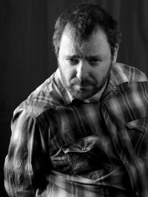
About Me
Personal Biases/Personal Position
Ancestry—Why this is important
Programmer
Robotics Research Engineer
Independent Web Development Contractor
Business Programmer
Game Programmer
Educator
Liverpool University, UCOL, Unitec, Media Design School

Slide 3
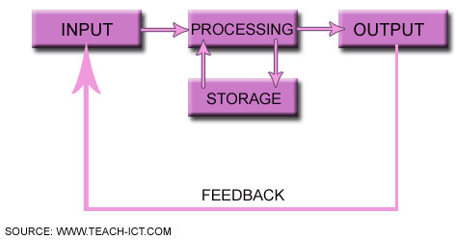
About Programming Fundamentals
We will be learning about programming
Programming is essentially:
Take inputs
Process the inputs
Create outputs
We will be using Python to learn about programming and programming theories.

Slide 4
Common Misconceptions
It is a common misconception that
programming is difficult.
you have to be a mathematical whizz to be a programmer.
that only nerds or geeks can program.
that programming is wizardry or magical.

Slide 5
Breaking the Misconceptions
Programming is a learned skill that takes practice.
It can be time consuming but putting in the work pays off.
Mathematics
Being a mathematical whizz and programmer opens more opportunities.
There are more opportunities for programmers!

Slide 6
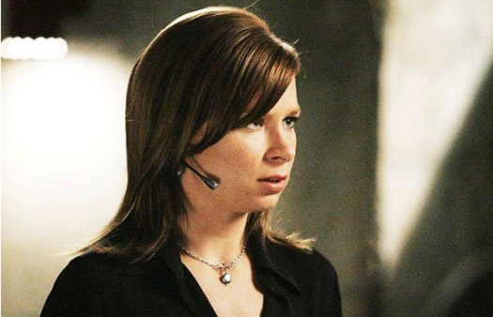
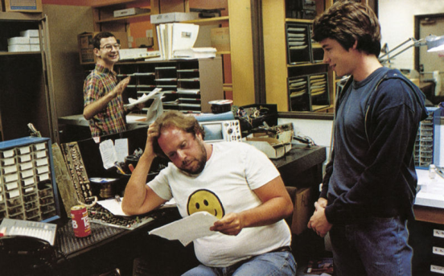
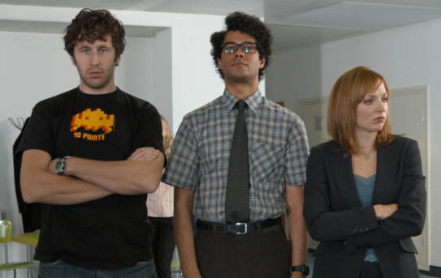
Breaking the Misconceptions
The media for the past 30 years has shown IT professionals as geeks and nerds and non-personable.
This assists in falsely representing us.
Chloe O’Brien from the 24 Universe. Not very good with people but amazing IT lady.
Arguably the first computer nerds, in the motion picture War Games. The fat version and the self-important guy with no people skills.

Slide 7
Programming is not Magical
You are in control.
We are telling the computer what to do.
We will show you how you can get more information from the computer.
We make the computer do the donkey work.
We do the thinking.
The computer does what you tell it to do…
In the order that you determine!

Slide 8
Input/Process/Output
You are in control because you know how to ask questions.
We can verify the input/output at each stage during the process
You think know what the inputs are…
Does the destination require a different form of input?
Input
Process
Output
Is the input what you expect?
Do we have to verify the input?
Is the output what you expect?
Do we have to prepare the output?

Slide 9
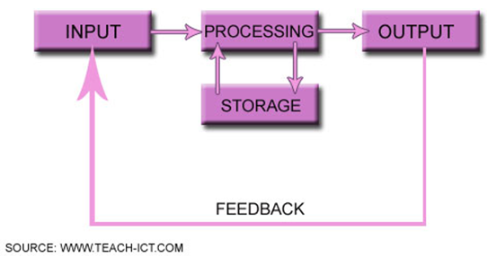
First Year
We are writing programs that should work independent of the platform.
Eventually you will have to write platform specific code that requires the understanding of various operating systems
Operating Systems Fundamentals
We will talk a little about hardware
A greater level of understanding of hardware can increase the performance of your programs and can dictate how you program
Hardware Fundamentals
The source of your data is either from a file or in your program.
Eventually it can be sourced from a database
Introduction to Databases
We will give you designs and concepts to implement
Eventually you will have to interview people to determine the requirements of their programs
Information Systems Concepts
We will be expecting you to experiment and do self-directed study.
Eventually you will have to be able to learn and experiment with new technologies as this is an integral part of the IT practitioner’s role
Professional Skills for IT Practitioners

Slide 10
How do I pass?
Show up, on time, attend all classes.
Complete all the exercises in class.
Complete all the self-directed activities.
Submit all work on or before the deadline.
Attend and complete the exam.
Ask for help…
There are many of you and I cannot read minds!
Ask for help from each other also!
Questions! Questions! Questions!

Slide 11
How do I pass?
Learning hours:
You are expected to complete approximately 150 hours worth of learning for this subject.
Build a schedule of times that you will work.
You have lots of time to play outside of your scheduled times.
Stick to your schedule.
Programming is a learned skill…
So cramming work the night before will not be an optimal use of your time.

Slide 12
How do I pass?
Build your schedule.
Each of your first year papers requires approximately 10 learning hours per week.
You have classes for 4 hours per week so schedule 6 hours of self-directed time.
Time | Monday | Tuesday | Wednesday | Thursday | Friday
9:00-10:00
10:00-11:00
11:00-12:00
12:00-13:00
13:00-14:00
14:00-15:00
15:00-16:00
16:00-17:00

Slide 13
How do I pass?
Set up study groups.
Learn together.
Discover “cool” stuff and share it with each other.
You can build your schedule together so that you always meet at the same time.
If you can meet after class, this can be more achievable.

Slide 14
What to do in self-directed time?
Re-read the handouts and slides.
Work on the exercises.
Work on your assignments.
Read additional materials.
Find additional materials.
Experiment with different ways of coding.
Ask yourself questions:
How do the other courses relate to programming?
How could I use this programming concept in my own work?

Slide 15
Assessments
Three practical tests—open book.
These are always open book and you can use your existing code.
One practical assignment.
This will be improvements to an existing game program.
One open-book examination.
You will be given enough time to complete the exam twice over.
This will be a combination of language, program design and theory.

Slide 16
Recap
Do the work.
Submit work on or before the deadline.
Attend all classes on time.
Build a study plan.
Stick to your plan.
Create study groups.
Assessments.

Slide 17
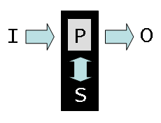
Programming
Remember always ask questions!
Course Overview
Essentials
Some Terminology
Why it is important
About Inputs
About Outputs
About Processing
About Storage

Slide 18
How it works
In the Lecture we will:
Explore programming concepts, terminology and ideas.
In the tutorial we will:
Explore those things in more depth with some practical exercises and finding good information online.
In the practical classes we will:
Explore programming concepts using exercises and undertake our assignments.

Slide 19
Course Overview
Week | Theory | Practical Classes | Exercises/Assessments
1 | Overview | Input/Processing/Output | Practical Exercises
2 | Syntax | Variables/Constants/Literals | Practical Exercises
3 | Semantics | Arrays/Lists/Tuples | Practical Exercises
4 | Problem Definitions | Decisions/Logic | Practical Exercises
5 | Functional Design (IO) | Input / Output Formatting Loops and Repetitions | PRACTICAL TEST ONE
6 | Functional Design (Processing) | Text-base User Interfaces | Practical Exercises
7 | Functional Design (Processing) | Functions / Methods / Objects / Classes | Practical Exercises
8 | Functional Design (Validation) | Data Validation | Practical Exercises

Slide 20
Course Overview
Week | Theory | Practical Classes | Exercises/Assessments
9 | Recap/Program Design | Testing and Debugging | PRACTICAL TEST TWO
10 | Program Testing | Assignment Project | Assignment Project
11 | Program Debugging | Assignment Project | Assignment Project
12 | Program Documentation | Assignment Project | Assignment Project
13 | No class | Assignment Project | PRACTICAL TEST THREE
14 | STUDY WEEK | Assignment Project | ASSIGNMENT PROJECT HAND-IN
15 | EXAM WEEK | EXAM WEEK | EXAM WEEK
16 | EXAM WEEK | EXAM WEEK | EXAM WEEK

Slide 21
Essentials
Programming is essentially:
Take inputs
Process the inputs (perhaps store some info)
Create outputs

Slide 22
Terminology
Programmers use mostly the same terminology to describe their concepts. Sometimes there are differences, this can cause confusion.
When programming in any language a common terminology is used.
You should learn this terminology.
You will be able to find answers to questions more quickly.
When you read the materials and come across a word you do not understand write a definition.

Slide 23
Input/Process/Output
Input is the information that is provided to the computer.
This is what the user gives us.
Process is an activity that converts the input into the output.
Output is the information that our program produces.
This is based on the input.
name=input(“What is your name?”)
age=input(“What is your age?”)
outputMessage = “Hello ”+name
if age > 21:
outputMessage += “, do you want a beer?”
print (outputMessage)

Slide 24
Input/Process/Output
In this class, the input will be from:
Files or from the user.
Later (in the degree!) we will get information from a variety of sources:
Databases
Sensors
Cameras
Operating Systems
Hardware Performance Data
Other Computer Systems

Slide 25
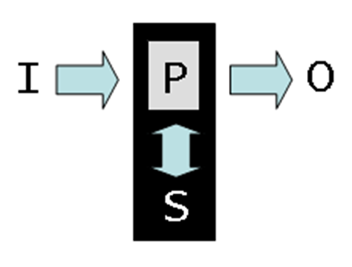
Output
In this class, the output will be mostly:
Files and screen textual presentation, if we get time some graphics!
Later in the degree we will output:
To other systems.
2D graphical devices.
3D graphical devices.
Sound systems.

Slide 26
Processing
We will be using procedural programming in this course.
We will use objects and classes.
A procedure is simply a function that we call to convert inputs into some desired output.
Later you will learn other types of programming including
Object Orientated Programming.
However, we do not need to go to that level of detail at this point.
def isAdult(age) :
return age >= 18
age=input(“What is your age?”)
outputMessage = “Hello ”+name
if isAdult(age):
outputMessage += “, do you want a beer?”

Slide 27
Inputs
Inputs can be
Literals—A value.
10, David, are literal values.
Variables—A variable is a placeholder for a value, it can change.
your latitude and longitude position changes.
Constants—A constant is a placeholder for a value, that cannot or does not change.
pi is an example of a constant.
superUser=“David”
latPosition=input(“What is your latitude position?”)
longPosition=input(“What is your longitude position?”)
pi = 3.14159265358979323846264338…

Slide 28
Arrays/Lists/Tuples
An array is a collection of values.
A list of objects which are the same size and type.
A list is a collection of values.
a number of connected objects.
A tuple is a set of values that are usually related.
(Latitude, Longitude, Altitude)
NOTE: In Python, we have a list. That is more than an array!
employers = [“Sandwell MBC”, “Liverpool University”, “Ministry of Defence”, “UCOL”, “Media Design School”, “Compac Sorting Equipment”, “Contractor”, “Media Design School”, “Unitec”]
latLong = (37.2333, 175.0167)

Slide 29
Decisions/Logic/Loops
Inputs consist of:
Literals, variables and constants
Processing is a collection of:
Decisions and logic based on the inputs
Often our processing is achieved by doing things multiple times using loops
def isLeapYear(year):
if year % 400 == 0:
return True
elif year % 100 != 0 and year % 4 == 0:
return True
return False

Slide 30
Functions
A function is our building block for processing.
Inside the function is decisions, logic and uses of inputs.
A function often returns a value.
def getSum(listOfNumbers):
sum = 0
for eachNumber in listOfNumbers:
sum+= eachNumber
return sum

Slide 31
More Terminology
As we progress through the course.
We will discuss this terminology again.
We will give you more terminology.

Slide 32
Recap
How to pass.
What to do.
Course schedule.
Some basic terminology.
Ask questions!

